Slide 1
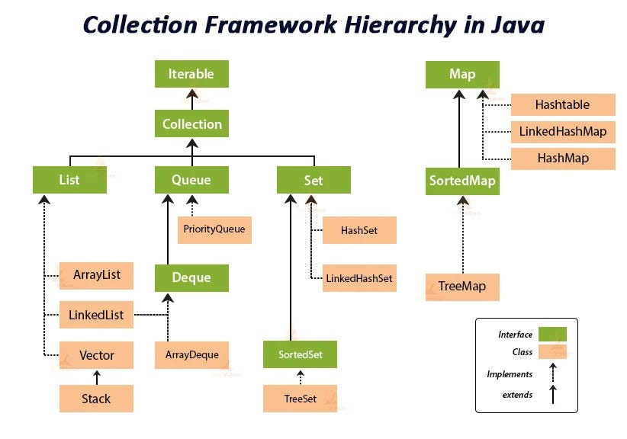
M04 L22 Introduction to Maps

Slide 2
Today
Project: Working on feedback and will release the test script used after Friday.
F25_CS2050_Schedule
Final Tech document for course following Best Practices for Developer Documentation - Dec 9th
Project Iteration 02 - Due Nov 21st
Take Home Final Demonstration of Learning Due December 9th
Goals
Hashmap
Understand what a HashMap is and when to use it.
Practice storing and retrieving objects using .put() and .get().
Compare using a HashMap vs. searching a list.
Set up
Open up code from last lecture CollectionSortBooksLinkedList.java in Eclipse

Slide 3
:: (Method Reference Operator)
The :: operator tells Java to use an existing method instead of writing it out again. It’s a shortcut that refers to a method by its name.
books.sort(Comparator.comparing(Book::getTitle));
Book::getTitle means use the getTitle() method from the Book class when comparing books.”
So Java will call getTitle() on each book while sorting so for each Book use its title.

Slide 4
Book Lab: Collections Sort
Review and Discuss last lecture concepts
Explore book example CollectionSortBooksLinkedList.java code using the debugger.
Explore the steps already completed then add code for the following steps
Step 4: Add code to sort books by year (newest to oldest) and print the results
Step 5: Add code to sort books by author, then title, and print the results.
Step 7: Add code to process signed-out books if any exist. Remove each from the queue and print a message: Signed out: <book> Then print the remaining inventory.
Step 9: Update the findBooks() method to search books by author and year and return only those that match, sorted by title.

Slide 5
What is a Map?
A Map is a Java collection that stores data in key–value pairs. Unlike a List or Set, which store individual elements, a Map lets you look up values using unique keys.
Each key is unique.
Each key maps to exactly one value.
Common real-world example: a dictionary (word = key, definition = value).
Common Implementations:
HashMap — fast lookups, no guaranteed order.
TreeMap — sorted by keys.
LinkedHashMap — maintains insertion order.
This is where a HashMap helps find a book
What if you could instantly grab the book you wanted using just the title as a key?

Slide 6
How does a HashMap Work
When you call put(key, value) in a HashMap, Java performs the following steps:
It computes a hash code for the key using the hashCode() method.
It uses the hash code to determine which "bucket" (internal array slot) to store the entry in.
If two keys have the same hash code (a "collision"), it stores them in a list or tree at that bucket.
When you later call get(key), Java:
Computes the hash code of the key.
Jumps directly to the bucket where that key should be.
Searches only within that bucket to find and return the matching value.
Internally, a HashMap is built on two ideas:
An array of buckets (like bins).
Linked lists or trees inside each bucket to handle collisions.
This process is what makes HashMap so fast compared to searching through a List.
Do not worry about details now as you will use the hashmap as an abstraction where you do not need to know how it is implemented.

Slide 7
Common Map Methods
A HashMap is a data structure that allows you to store and retrieve key-value pairs very efficiently
Method | Description
put(key, value) | Adds or updates a key-value pair
get(key) | Returns the value associated with the key
remove(key) | Removes the key and its value
containsKey(key) | Returns true if the key exists
containsValue(value) | Returns true if the value exists
keySet() | Returns a Set of all keys
values() | Returns a Collection of all values
entrySet() | Returns a Set of key-value pairs (Map.Entry<K, V>)
isEmpty() | Checks if the map has no entries
size() | Returns the number of entries in the map

Slide 8
HashMap
Key idea: HashMap<K, V> lets you store key-value pairs.
Like a dictionary where can look up a word (key), get the definition (value).
Declare a map as HashMap to store key-value pair
Use put method to add or update a key-value pair
Use get to return the value of the key
Map<String, Book> bookMapByTitle = new HashMap<>();
bookMapByTitle.put("Hello World", new Book(...));
Book myBook = bookMap.get("Hello World");
What is the key?
What is the value?
What happens if we use .get("Not a Book in map")?

Slide 9
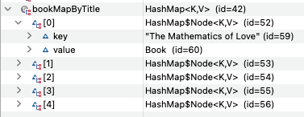
Example Book Map Creation, Put and Get
Create a Map to look a book up by a title
Book Map uses title as the key and Book as the value.
Step 1: Create the map
Step 2: Look up by Title
Key | Value
“Hello World” | Book instance (reference variable)
“Unmasking AI” | Book instance (reference variable)
Map<String, Book> bookMapByTitle = new HashMap<>();
for (Book currentBook : bookInventory) {
bookMapByTitle.put(currentBook.getTitle(), currentBook);
}
String searchTitle = "Hello World";
if (bookMapByTitle.containsKey(searchTitle)) {
System.out.println("Found book: " + bookMapByTitle.get(searchTitle));
} else {
System.out.println("Book not found: " + searchTitle);
}

Slide 10
Book Map More Methods
if (bookMapByTitle.isEmpty()) {
System.out.println("No books in the map.");
}
Check if the map is empty:
Get the number of entries in the map:
Remove a book by title:
Loop through all keys (titles):
Loop through all values (books):
Loop through key-value pairs:
System.out.println("Total books: " + bookMapByTitle.size());
bookMapByTitle.remove("Hello World");
for (String title : bookMapByTitle.keySet()) {
System.out.println("Title: " + title);
}
for (Book book : bookMapByTitle.values()) {
System.out.println(book);
}
for (Map.Entry<String, Book> entry : bookMapByTitle.entrySet()) {
System.out.println(entry.getKey() + ": " + entry.getValue());
}

Slide 11
Lab: Explore Code for HashMap
What happens if you add a book to the linkedlist with the same title?
// Step 10: Use HashMap to organize books by title
System.out.println("\nStep 10 HashMap of books by title:");
Map<String, Book> bookMapByTitle = new HashMap<>();
// Using for loop to create hashmap quickly for book titles
// Remember title must be unique
for (Book currentBook : bookInventory)
{
bookMapByTitle.put(currentBook.getTitle(), currentBook); // key = title, value = book
}
// Try getting a book by title
String searchTitle = "Hello World";
// containsKey Returns true if the key exists
if (bookMapByTitle.containsKey(searchTitle))
{
System.out.println("Found book: " + bookMapByTitle.get(searchTitle));
} else
{
System.out.println("Book not found: " + searchTitle);
}
What happens if you add a book to the hashmap with the same title?
If you wanted to find all books by Hannah Fry, would a HashMap still work best? Why or why not?

Slide 12
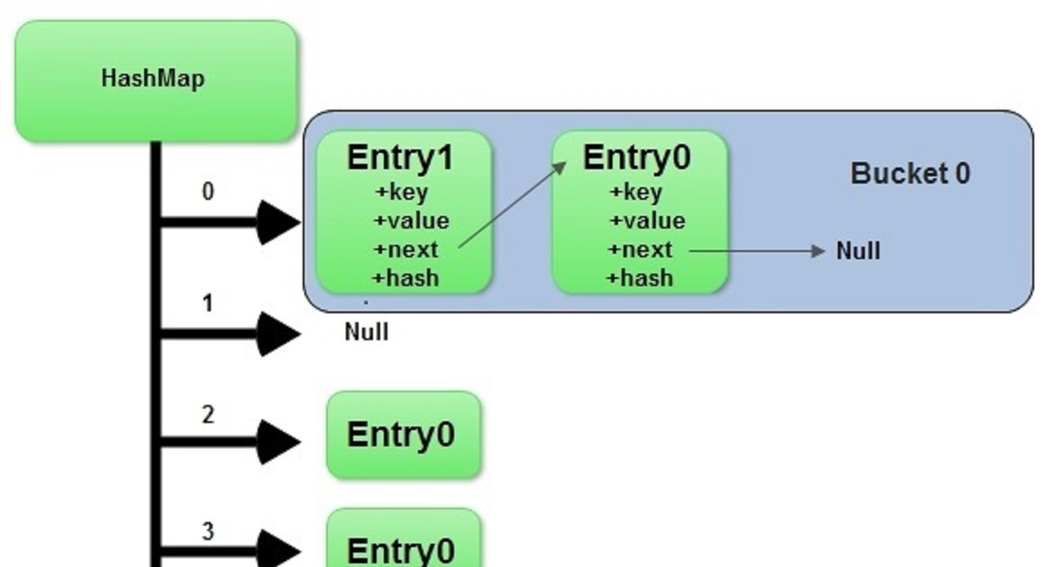
Lab: Explore Different Preconditions
System.out.println("Find a book by title:");
System.out.println(bookMapByTitle.get("Unmasking AI"));
System.out.println(bookMapByTitle.get("Not in list"));
Add the code and discuss discuss:
What happens when the key isn’t found?
Why does a Map return null instead of throwing an error?
Add one new Book with an existing title.
What happens to the old one? Why?

Slide 13
Discoveries
Question | Key Takeaway
What happens if you add a book with the same title? | The old value is replaced (keys are unique).
What happens if you add duplicate titles to a LinkedList? | Both stay because lists allow duplicates.
Would a HashMap be best to find all books by one author? | No should use a Map<String, List<Book>>.

Slide 14
Lab: Explore Code for TreeMap
In a TreeMap, the keys are sorted automatically by year
Java prints 2015 → 2016 → 2018 → 2019 → 2023.
Discuss with a partner before running your code.
How does using a HashMap make lookups faster than a List?
What data type is used for the key? the value?
When would you choose a TreeMap instead?
When a key isn’t found, why does Java return null instead of throwing an error?
// step 11 Create a TreeMap to organize books by year
System.out.println("\nCreate and print tree map");
TreeMap<Integer, List<Book>> booksByYear = new TreeMap<>();
// Group books by year (keys are sorted automatically)
for (Book currentBook : bookInventory){
int year = currentBook.getYear();
if (!booksByYear.containsKey(year)) {
booksByYear.put(year, new ArrayList<>());
}
booksByYear.get(year).add(currentBook);
}

Slide 15
Lab: Discoveries – TreeMap
// step 12 Print books by year (TreeMap keeps them sorted)
for (Map.Entry<Integer, List<Book>> entry : booksByYear.entrySet()){
System.out.println("\nYear: " + entry.getKey());
for (Book book : entry.getValue())
{
System.out.println(book);
}
}
Key (Title) | Value (Book Object)
"Hello World" | Book object
"Unmasking AI" | Book object
TreeMap automatically sorts keys, so books print from oldest to newest year.

Slide 16
Grouping Data by Author
If you want to find all the books by Hannah Fry a regular HashMap<String, Book> would not work best, because:
Each key in a HashMap must be unique.
An author like Hannah Fry has multiple books, so one key (“Hannah Fry”) would overwrite earlier entries.
You wouldn't normally use HashMap<String, Book> for authors because many authors write more than one book.
A HashMap<String, Book> can only store one book per author, so later entries overwrite earlier ones.
Instead, use HashMap<String, List<Book>> to group books by author. Using HashMap<String, List<Book>> lets you group all of an author’s books together.
This is a real design decision: What structure matches the data relationship? One-to-one → Map<K, V> One Author one Book? One-to-many → Map<K, List<V>> One Author many Books?

Slide 17
Lab: When One Key Has Many Values
We’re still using a Map, but instead of one book per key, we’re storing a list of books for each author.
Each key is the author’s name (String).
Each value is a List<Book> — all books written by that author.
putIfAbsent() ensures that each author’s list is created only once.
get(author).add(book) then adds the current book to that list.
Maps can also store collections as values. When one key (like an author) can have multiple related items,use a Map<K, List<V>> to group them.
Map<String, List<Book>> booksByAuthor = new HashMap<>();
for (Book book : bookInventory) {
// If the author isn't in the map yet, create a new list for them
booksByAuthor.putIfAbsent(book.getAuthor(), new ArrayList<>());
// Add this book to the author's list
booksByAuthor.get(book.getAuthor()).add(book);
}
How could you print all books by Hannah Fry from booksByAuthor?

Slide 18
Comparing the Maps
Type | Purpose | Ordering
HashMap | Fast key lookups; no guaranteed order. | Unordered
TreeMap | Automatically sorts keys (e.g., by year). | Sorted by key
LinkedHashMap | (Introduce next time) Keeps the order items were added. | Insertion order
Goal | Best Choice | Why
Find one book by title | HashMap<String, Book> | Title is unique
Find all books by an author | HashMap<String, List<Book>> | Author has multiple books
Print books in year order | TreeMap<Integer, List<Book>> | Keys sorted by year

Slide 19
Where Used
HashMap is one of the most widely used Java collections because it provides fast lookups, inserts, and updates (O(1) average time).
It’s used whenever software needs to associate keys with values and access them quickly.
Category | Example Use | Why HashMap Fits
Configuration & Settings | Store user preferences or environment variables (key = setting name, value = value). | Quick lookup by key; easy updates.
Databases & Indexing | Map record IDs to objects or metadata. | Direct access to records by ID.
Web Applications | Store session data (key = session ID, value = user info). | Efficient retrieval of user state in scalable systems.
Authentication Systems | Map usernames or tokens to user profiles. | Fast validation without re-querying the database.
Compilers / Interpreters | Map variable names to memory addresses or symbol info. | Enables constant-time variable resolution.
Analytics / Counting | Track word counts, event frequencies, or product sales (key = item, value = count). | Ideal for counting or aggregating unique items.

Slide 20
Maps vs Lists
Feature | List | Map
Stores | Individual elements | Key–value pairs
Index-based? | Yes (e.g., list.get(0)) | No (access with map.get(key))
Duplicates | Allows duplicate values | Keys must be unique
Access pattern | Access by index | Access by key
Use case | Ordered collection of elements | Fast lookup of value by key
A List<String> might hold a list of book titles.
A Map<String, Book> might map each title to a Book object with more details.

Slide 21
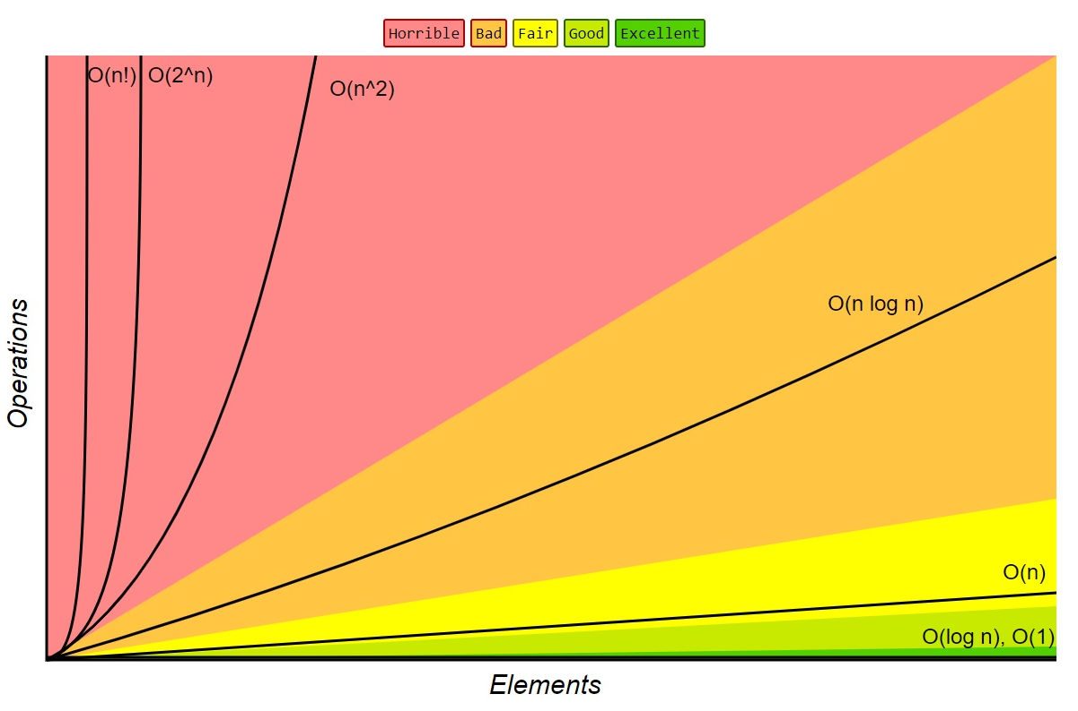
Big O Time Comparisons Review
Operation | Big-O Notation | What It Means
Constant | O(1) | Same time no matter how big the data
Linear | O(n) | Slower as data grows
Logarithmic | O(log n) | Grows slowly (e.g., binary search)
Quadratic | O(n^2) | Gets slow fast (nested loops)

Slide 22
Summary: Linear Data Structures
See how you must really understand the data and the functionality to model data with different data structures when solving a problem.
Choosing the right collection depends on how many values each key should represent.
Feature | Array | ArrayList | LinkedList
Size fixed? | Yes | No | No
Fast access by index? | Fast (O(1)) | Slower (O(n)) | Slow (O(n))
Easy insert/remove? | No | OK (end is best) | Yes (anywhere)
Great for 2D structures? | Yes | No | No
Best for queues/stacks? | No | Maybe | Yes

Slide 23
Summary Map Data Structures
Feature | HashMap | TreeMap | LinkedHashMap
Key–Value pairs | Yes | Yes | Yes
Keeps order? | No | Sorted by key | Insertion order
Access by key | Fast (O(1) avg) | Slower (O(log n)) | Medium (O(1) avg)
Allows duplicate keys? | No | No | No
Allows duplicate values? | Yes | Yes | Yes
Typical use | Lookup by ID, name, or title | Sorted reports (e.g., by year) | Ordered display (e.g., playlists)

Slide 24
Preparation
Finish labs and update technical documentation.
Resources
DS HashMaps
8.4 Maps Revisited: Skip Lists
summary-of-map-adt-implementations
If you want to explore more but not necessary - How HashMap works in Java?
Skip the deep dive into “rehashing” and “load factor” for now — that’s beyond this course.
Since Java 8, buckets can use balanced trees internally instead of linked lists (no need to know this).
Emphasize: This course you will use HashMap as an abstraction — you don’t have to worry about how hashing works to use it effectively.

